Slide 1
Web Intermediate GET/POST and STORAGE
Lecture 4

Slide 2
Agenda
Post and Get Request
IsSET
Text Files (Read and Write)
Registration Form
CRUD Functions on file
Redirects

Slide 3
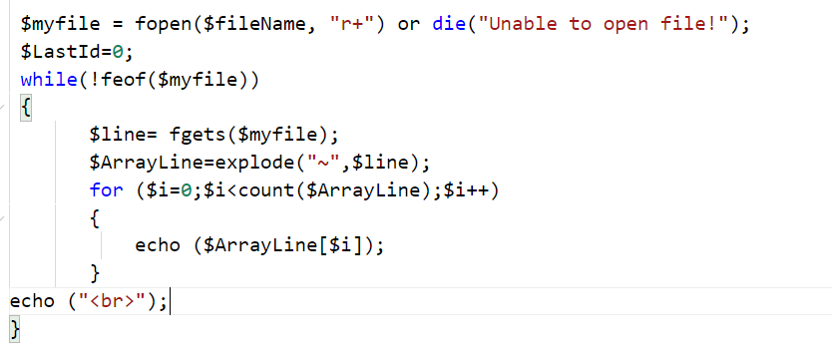
Read file line by line

Slide 4
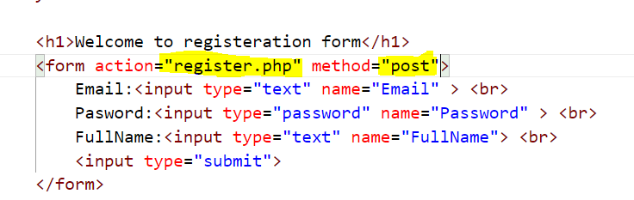
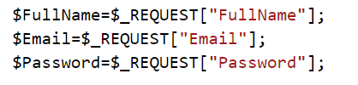
$POST and $GET $REQUEST

Slide 5
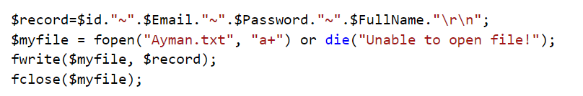
Write record to file

Slide 6
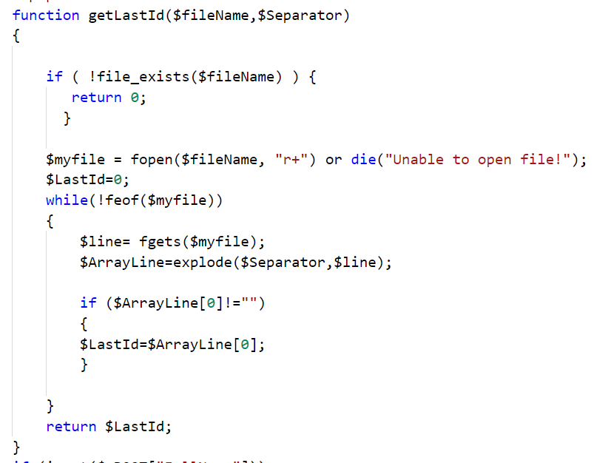
Get last ID from File

Slide 7
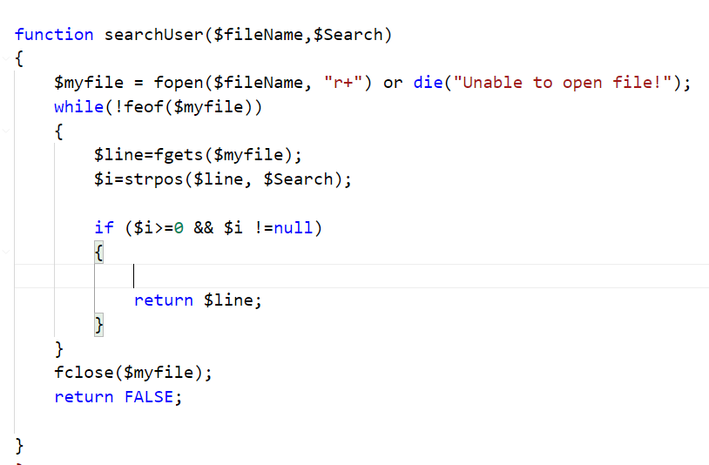
Search for user

Slide 8
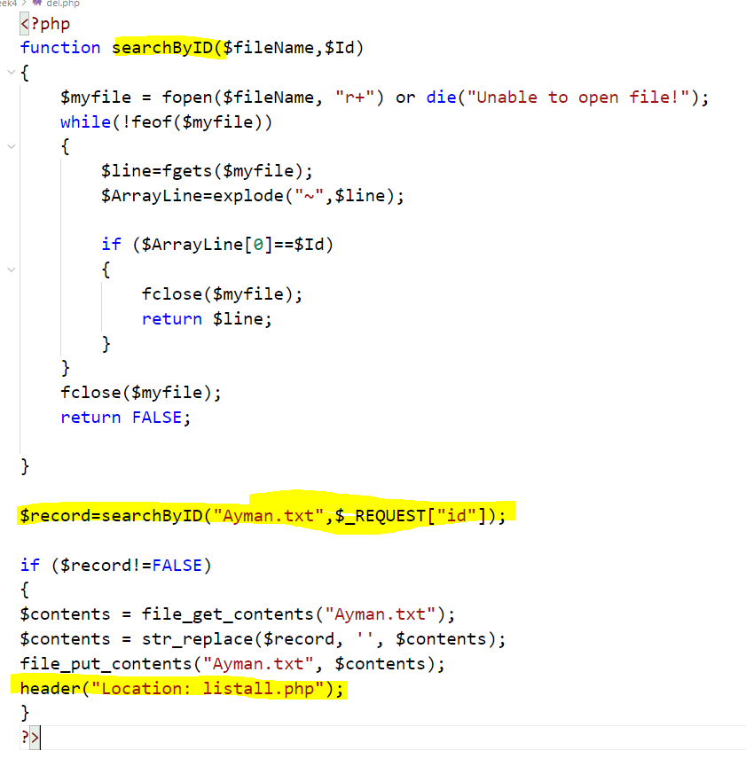
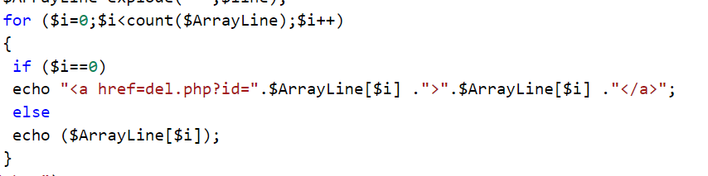
Delete Record

Slide 9
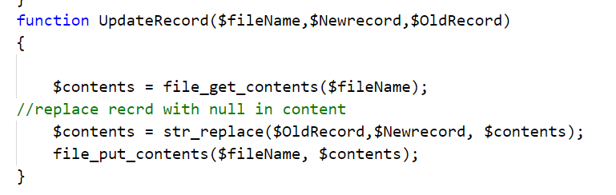
Update Record

